Slide 1


Slide 2

Sindh Madressatul Islam University
Attendance-Management-System
A simple, console-based C program to manage student attendance in-memory. This project is beginner-friendly and demonstrates the use of structs, arrays, and basic I/O in C.
Prepared By :
Okasha Nadeem
Muhammad Yahya Alvi
Muhammad Tabish
Syed Muhammad Sarim
Prepared For:
Miss. Iqra
ABSTRACT

Slide 3

ABSTRACT
This project is a console-based Attendance Management System developed in C.
It helps to register students and mark their attendance.
Attendance is marked as Present or Absent with a date.
Users can view all students and individual attendance records.
The project uses basic C programming concepts and stores data in memory.

Slide 4
^{Future Improvements}
^{Project Team}
10,09
^{Project Overview}
01.
08.
^{Limitations}
TOPICS
^{Key Features}
02.
07.
^{Function Summary}
^{Requirements}
03.
06.
^{Data Structures}
^{How to Run}
04,05
^{Program Flow}

Slide 5
Project Overview

Slide 6
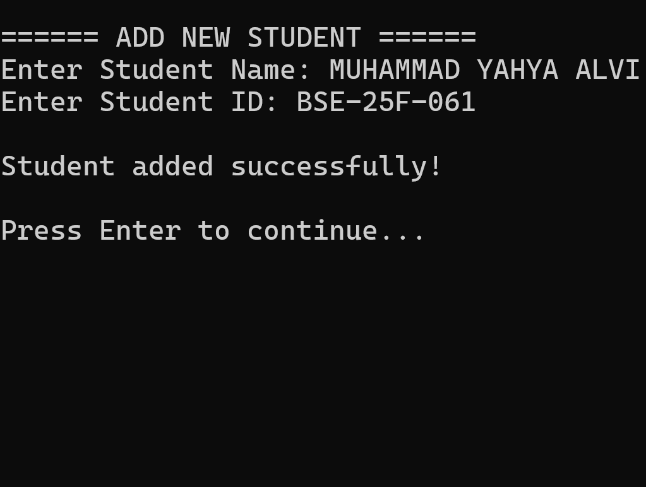
This project allows users to:
Register students (name and ID)
Mark attendance (Present or Absent) for a given date
View all students
View an individual student’s
attendance records
All data is stored in RAM, with a menu-driven console interface, making it ideal for learning core C programming concepts.
Project Overview

Slide 7
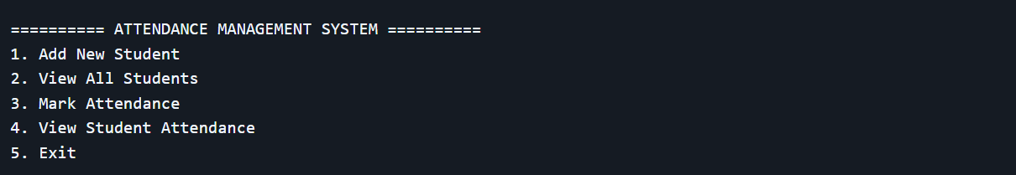
How to Run
Using Dev-C++
Create a New Project → Console Application → C Project
Add the .c file
Press F9 to compile
Run the program via Dev-C++
Requirements
C compiler (tested with GCC, Dev-C++, or MSVC)
Windows OS recommended for best experience (uses system("cls") for clearing console)
Basic console/terminal access
Program Flow
The program loops until the user selects Exit.
Users navigate via numeric menu input.
Key Features
Add new students with unique IDs
Mark attendance with user-specified date
View all registered students
View individual student attendance history
Menu-driven interface for simple navigation
Program Flow

Slide 8
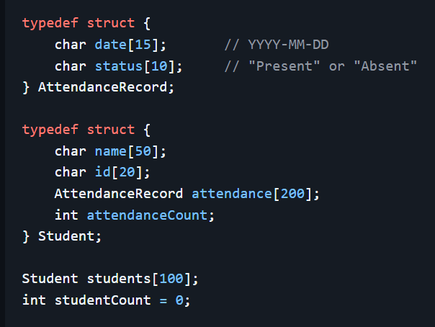
Data Structures

Slide 9
Function Summary
Function Purpose
Function Purpose
addStudent() Adds a new student
viewAllStudents() Displays all students
clearScreen() Clears console screen (Windows only)
1
2
Function Purpose
3
4
Function Purpose
markAttendance() Marks attendance for a student
viewStudentAttendance() Displays attendance records for a student
pauseProgram() Pauses execution and waits for user input

Slide 10
Function Summary
Function Purpose
Function Purpose
addStudent() Adds a new student
viewAllStudents() Displays all students
1
2
clearScreen() Clears console screen (Windows only)
Function Purpose
3
4
Function Purpose
markAttendance() Marks attendance for a student
viewStudentAttendance() Displays attendance records for a student
pauseProgram() Pauses execution and waits for user input
All data is lost on program exit (no file saving)
Maximum 100 students
Maximum 200 attendance records per student
Only supports Present / Absent statuses
Windows-specific console clear (system("cls"))
No duplicate ID prevention or date validatio
Limitations

Slide 11

Project Team:
Developed by a team of three:
Okasha Nadeem (Team Lead)
Muhammad Yahya Alvi
Muhammad Tabish
Syed Muhammad Sarim
Final project for Programming Fundamentals under the guidance of
Miss Iqra — SMI University
THE END
1.
Thank You Every One For Listening Carefully
2.
Now We Are Ready For your Question Reagards Over Project

